Slide 1




Utility Domain understanding demonstration

Slide 2


Table OF content
ELECTRICITY AND UTILITY
DUKE ENERGY

Slide 3
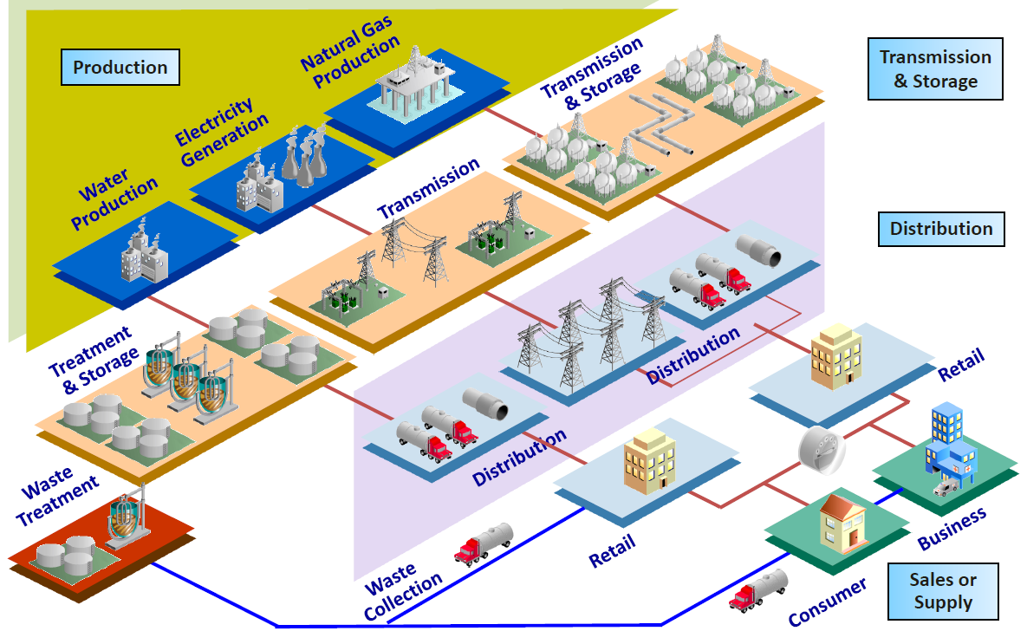
Utilities Value Chain

Slide 4
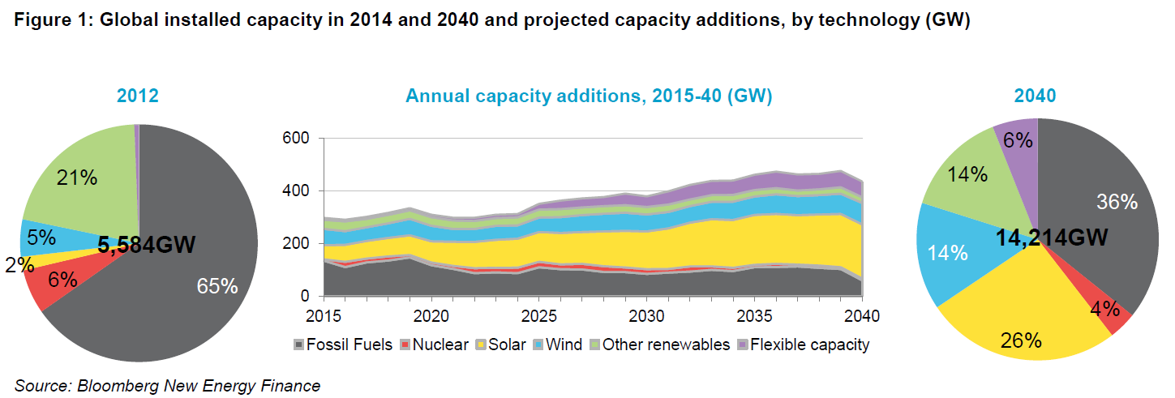
Distribution
McKinsey forecasts the renewable share to increase from 25% in the global power generation mix today to increase to 51% by 2035 and increase to 73% by 2050. While in 2035, wind still leads, from 2040 on solar is the #1. (Source: McKinsey Energy Insights’ Global Energy Perspective, January 2019)

Slide 5
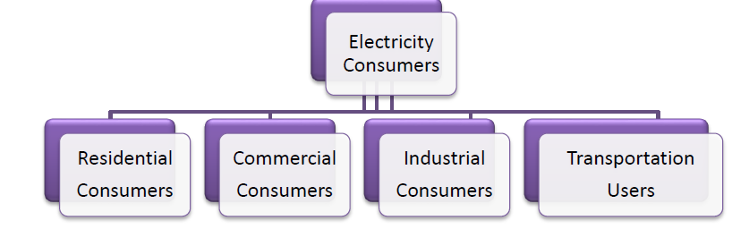
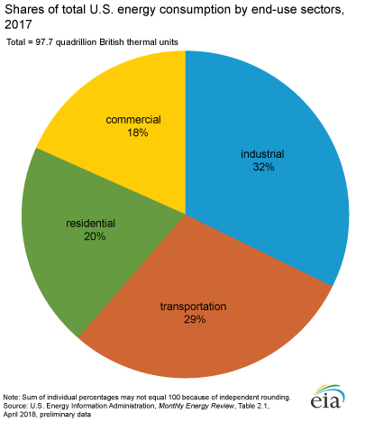
Who are electricity consumers?

Slide 6
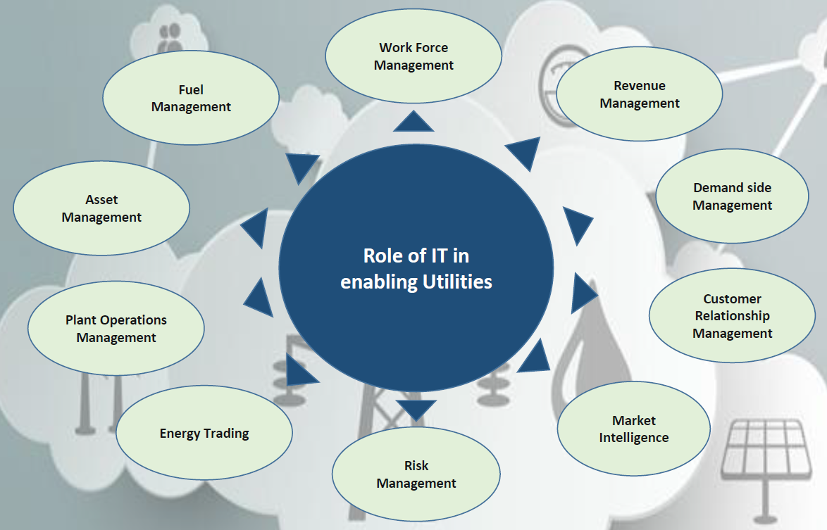

Slide 7
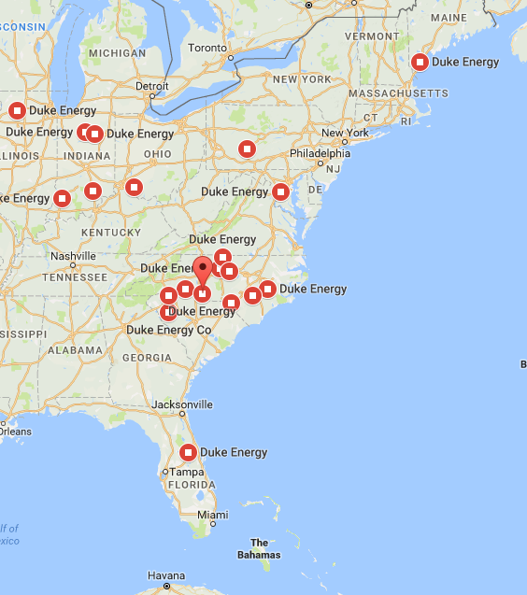

One of the Largest electric power holding company in United States
$23.56 B
Revenue in FY 2017
Subsidiaries:
Duke Energy Carolinas
Duke Energy Ohio
Duke Energy Kentucky
Duke Energy Indiana
Duke Energy Florida
Duke Energy Progress
Duke Energy Renewables
Duke Energy Retail
Duke Energy International
Operations in 6 states in US with assets also in Canada & Latin America
7.6 Million
Electric Customers
2nd largest Utility in US by Market Cap
1.6 Million
Gas
Customers
The company also provides natural gas to
1.6 million customers in five states and operates
a growing renewable energy portfolio across
the U.S.
29,060
Employees
Black Enterprise 40 Best Companies for Diversity
125
Fortune 500 List
Dow Jones Sustainability Index (DJSI) for North America for the 11th consecutive year
United Way North Carolina's Power of Commitment Award

Slide 11

Contact details
Bhawesh.gupta@cognizant.com

